Slide 2
Farming and Agriculture Software
Beginner

Slide 3
Activity scenario summary:
In this example we will code a project which replicates the running of a farming or agricultural business software.
This project will help you develop an understanding how coding is used in the agricultural industry and the importance of technology in the farming sector. This project should:
View Produce List
View Equipment List and Maintenance Cost
Available Fields
Occupied Fields
Calculate Profit from Crop Yield
Firstly, we’re going to allow the user to view our produce list and the equipment list

Slide 4
View Produce List
To view produce list:
For every item in the produce list, display its ID, name, price and value
Find the finished code for this project here – use this if you get stuck!

Slide 5
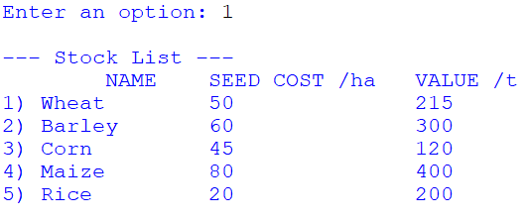
What will happen…
Find the finished code for this project here – use this if you get stuck!

Slide 6
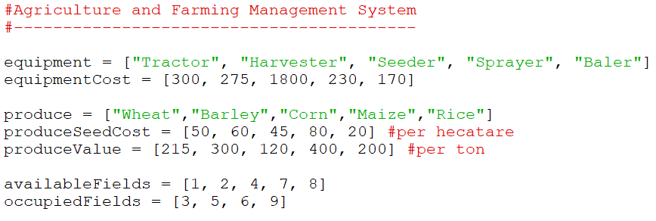
Step 1
At the top of your program, lets declare the variables that we’ll be using over the course of this program
Setting up our program…
In this part of the project, we’ll be focusing on the equipment and produce lists!

Slide 7
Step 2
First, lets declare a subroutine - subroutines are small blocks of code that perform specific tasks (such as displaying a list of produce)
Declaring a subroutine…
Print out some labels so the user knows what’s happening – we use ‘\t’ to put tab sized spaces between words

Slide 8
Step 3
Use a FOR loop to go through every item in our produce list
Displaying the contents of our list…
For every item, we’ll display its ID, the name of the produce, how much its seeds cost and how much its worth

Slide 9
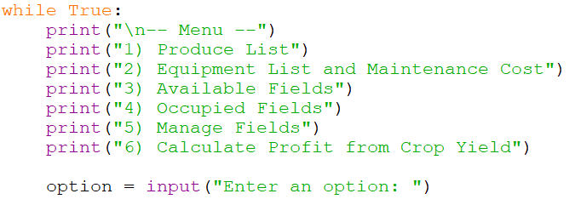
Step 4
For the menu, we are going to set up an infinite loop.
Setting up a menu…
Using print() statements, print out our user’s options, and ask which option the user would like to perform.

Slide 10
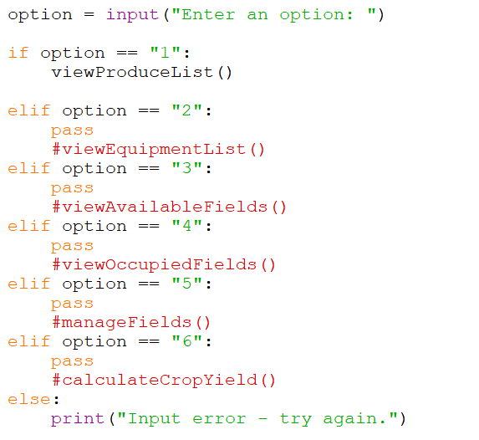
Step 5
Making our menu responsive…
To make the menu responsive, we’ll create a large IF ELIF ELSE statement – depending on which option the user enters, we will call a the corresponsing subroutine
So far, we only have our ‘viewProduceList()’, which we want to call when the user enters 1.

Slide 11
View Equipment List
To view equipment list:
For every item in the equipment list, display its ID, name and maintenance cost
Find the finished code for this project here – use this if you get stuck!

Slide 12
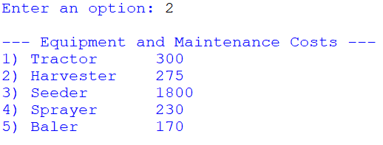
What will happen…
Find the finished code for this project here – use this if you get stuck!

Slide 13
Step 1
Declare another subroutine – this one will be responsible for displaying our list of equipment
Declaring a subroutine…
Print out some labels so the user knows what’s happening – we use ‘\n’ to print the information on a new line

Slide 14
Step 2
Use a FOR loop to go through every item in our equipment list
Displaying the contents of our list…
For every item, we’ll display its ID, the name of the equipment and how much it costs to maintain

Slide 15
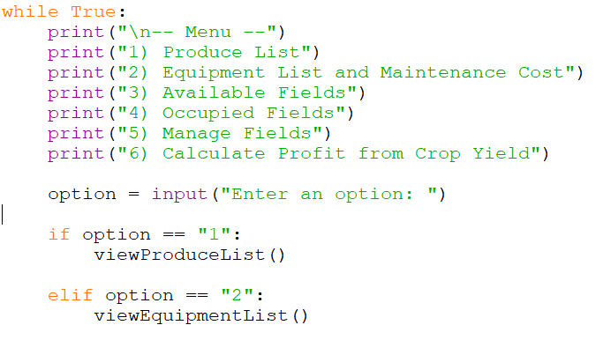
Step 3
Updating our menu…
Update the menu by calling the ‘viewEquipmentList()’ subroutine when the user enters 2.

Slide 16
What your code should look like so far…

Slide 17
What your code should look like so far…

Slide 18
Congratulations! You have completed the beginner code for the farming management system!

